Slide 1

Week 4 - Denoising Diffusion
Probabilistic Model
Mastering Diffusion
Yejoon Lee
AIDAS Lab
Seoul National University
leeyejoon@snu.ac.kr

Slide 2
Review

Slide 3
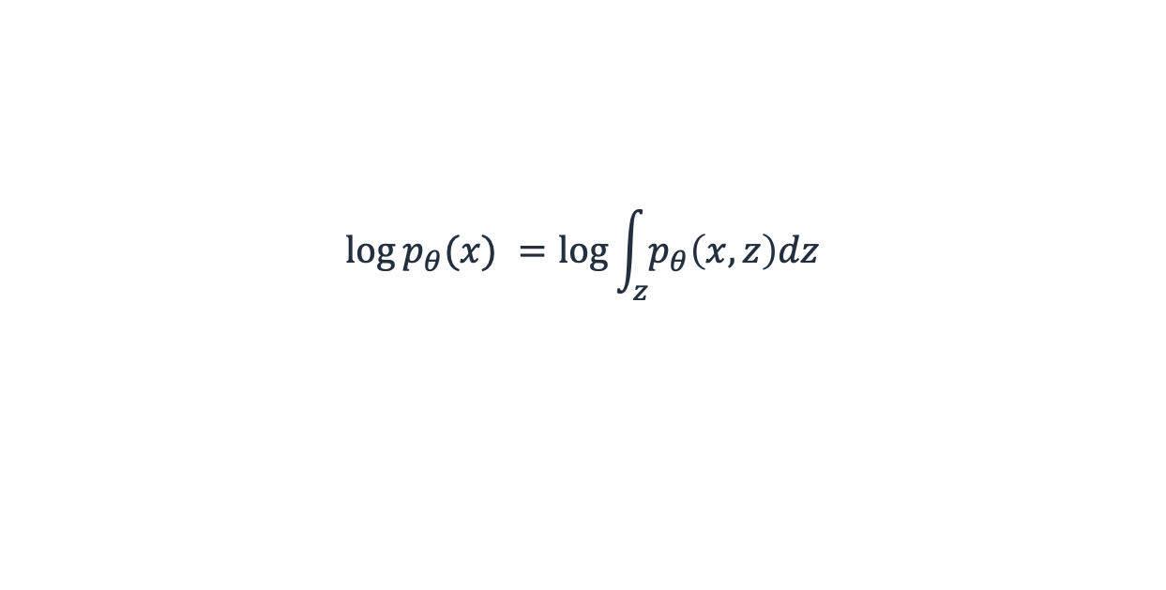


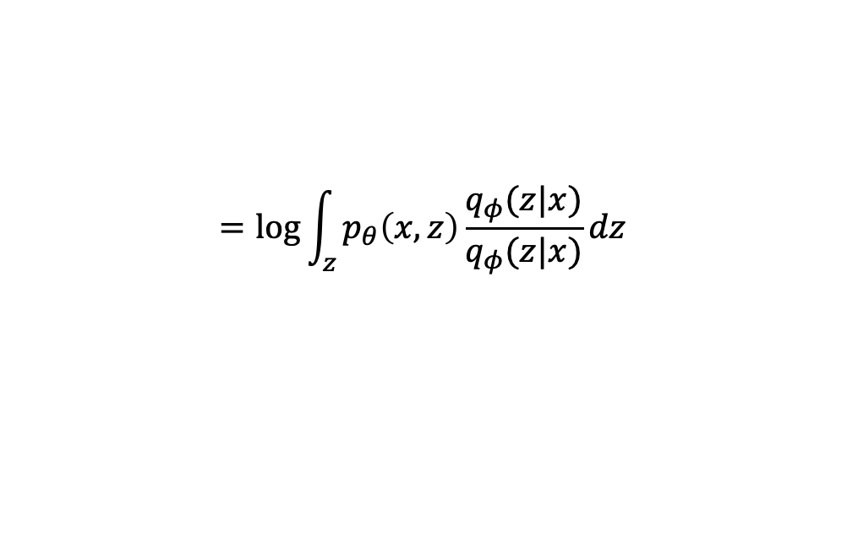
Variational Inference
$$\log{p_{θ}(x) }=\log{\int_{z}{p_{θ}\left(x,z\right)dz}}$$
Marginalization over latent variable z
$$=\log{\int_{z}{p_{θ}\left(x,z\right)\frac{q_{φ}(z|x)}{q_{φ}(z|x)}dz}}$$
$$=\log{𝔼_{z∼q_{φ}(z|x) }[\frac{p_{θ}\left(x,z\right)}{q_{φ}(z|x)}]}$$
For tractability, sample from q, not the entire z
$$≥𝔼_{z∼q_{φ}}[\log{\frac{p_{θ}\left(x,z\right)}{q_{φ}(z|x)}}]$$
For tractability, use Jensen’s inequality
$$=𝔼_{z∼q_{φ}}\left[\log{p_{θ}\left(x | z\right)p\left(z\right)}\right]−𝔼_{z∼q_{φ}}[q_{φ}(z|x)]$$
$$=𝔼_{z∼q_{φ}}\left[\log{p_{θ}\left(x | z\right)}\right]−D_{KL}\left(q_{φ}\left(z | x\right)||p\left(z\right)\right)$$
Variational bound from the last session
Notes:
In the last session, we’ve learned about variational inference. The goal of VI is to model the likelihood of x. However, as direct modeling is hard, we marginalize x over some latent z. This would require integration over the entire z which will be most of the times intractable. So we instead sample the latent z from some q and take an expection over this sampler z. Again for tractability, we use Jensen’s inequality, and this expectation becomes the objective of VI.
After some few tweaks, you can see that this obj is equiv. to the VI obj you’ve seen in the last session.

Slide 4
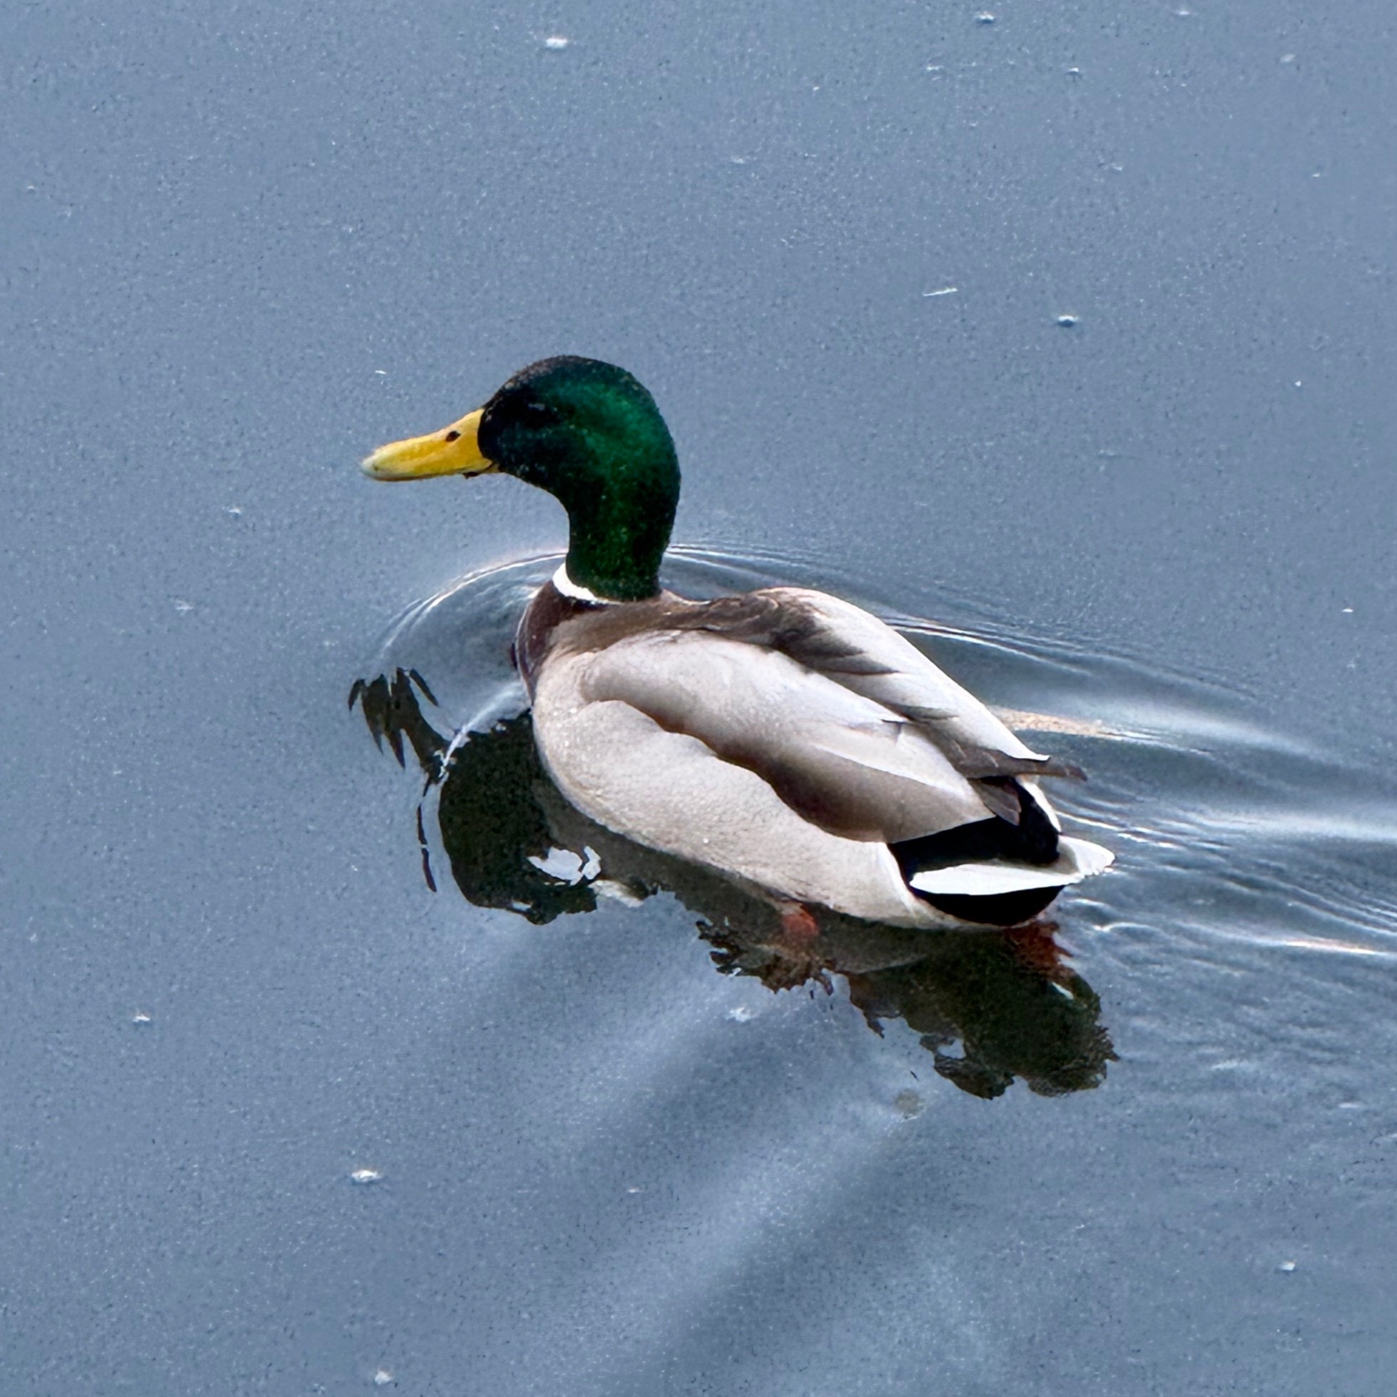
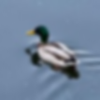


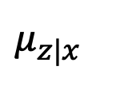
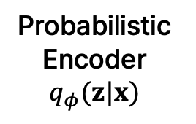
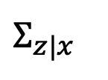

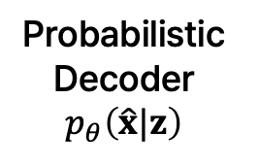
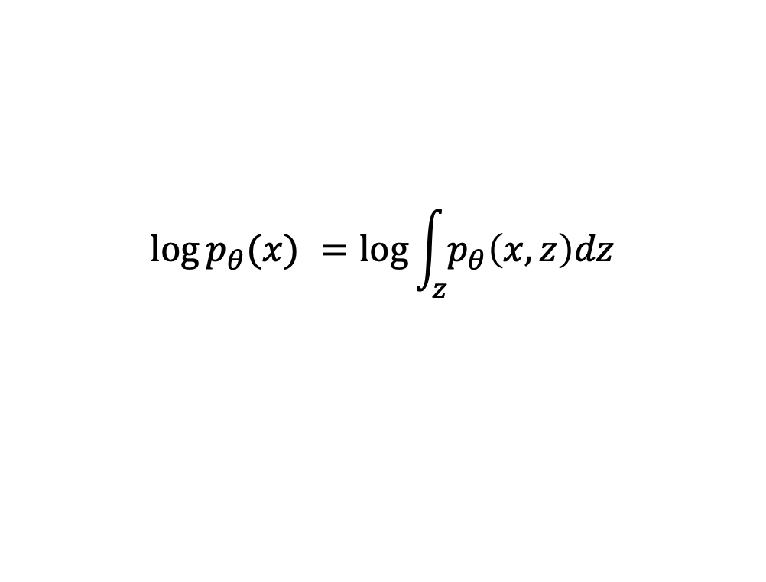
Latent variable in VAE is a random vector
Latent variable is a normally-distributed random vector
Probabilistic
Encoder
$$q_{φ}(z|x)$$
$$Σ_{z|x}$$
Probabilistic
Decoder
$$p_{θ}\left(\hat{x}|z\right)$$
$$z$$
$$μ_{z|x}$$
Image $x$
Reconstructed image $\hat{x}$
$$\log{p_{θ}(x) }=\log{\int_{z}{p_{θ}\left(x,z\right)dz}}$$
Notes:
We also learned about the model using VI, VAE. In VAE, the latent variable is a random vector.

Slide 5
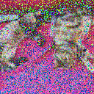
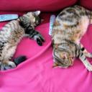

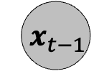

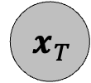
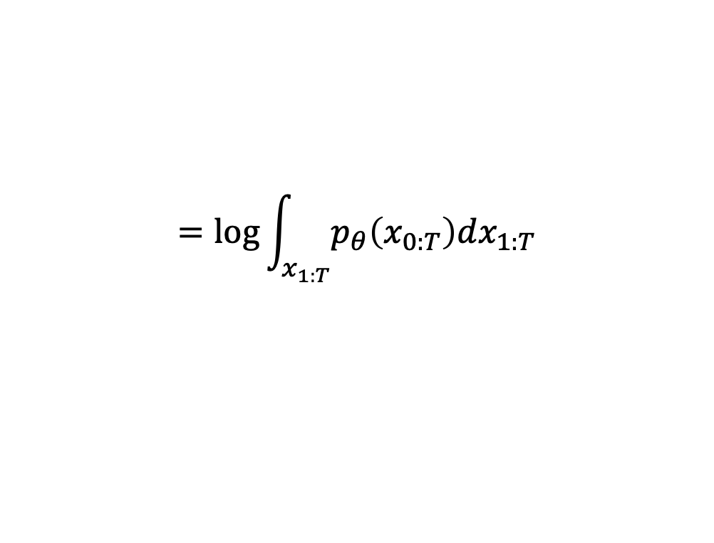


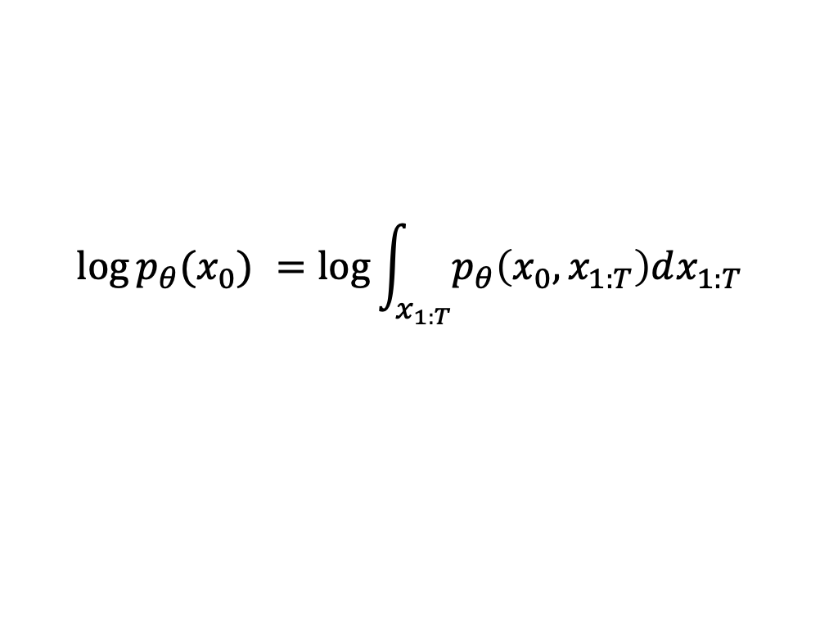
Latent variable in DDPM is a Markov chain of random vectors
Latent variable is a (normally-distributed) Markov chain of random vectors
$$p_{θ}(x_{t−1}|x_{t})$$
$$x_{T}$$
…
$$x_{t}$$
$$x_{t−1}$$
…
$$x_{0}$$
$$q(x_{t}|x_{t−1})$$
$$\log{p_{θ}(x_{0}) }=\log{\int_{x_{1:T}}{p_{θ}\left(x_{0},x_{1:T}\right)dx_{1:T}}}$$
$$=log{\int_{x_{1:T}}{p_{θ}\left(x_{0:T}\right)dx_{1:T}}}$$
Image credit: https://huggingface.co/blog/annotated-diffusion
Notes:
DDPM is just the same as VAE. The difference here is that latent variable is a (normally-distributed) Markov chain of random vectors. So there are multiple latent vectors rather than a single latent vector. And these latent vectors are chained via Markov propeorty. This means that the distribution of x_t is only affected by x_t-1, and not by x_t-2, x_t-3, so on.

Slide 6
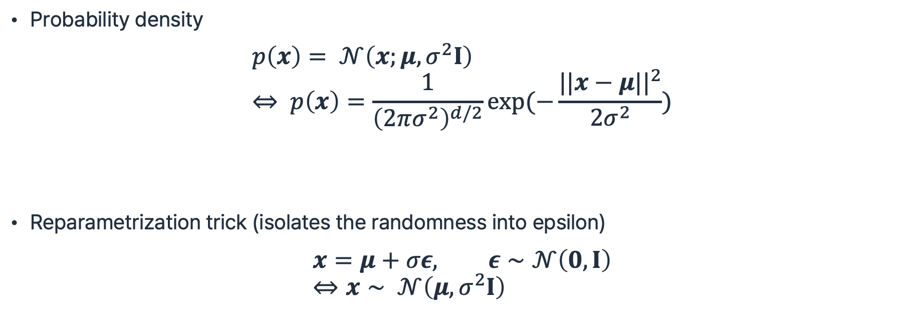
Notation in DDPM
Probability density
$$p\left(x\right)= 𝒩\left(x;μ,σ^{2}I\right) \\ ⇔ p\left(x\right)=\frac{1}{{\left(2πσ^{2}\right)}^{d/2}}\exp{(−\frac{||x−μ||^{2}}{2σ^{2}}})$$
Reparametrization trick (isolates the randomness into epsilon)
$$x=μ+σε, ε∼𝒩\left(0,I\right) \\ ⇔x∼ 𝒩\left(μ,σ^{2}I\right)$$
Notes:
There are some few notes on the notations used in DDPM. When we write as this, p(x) simply means the density of this Gaussian. Note that we wrote the variance as a scalar multiple of identity. This is known as an istropic Gaussian. In DDPM, this special case of Gaussian will be mostly used.
Second is the reparam trick. If we write x like this, it simply means that x is a Gaussian random vector with mean ~ and varaicne ~. The benefit of this notation is that we isolate the randomness to eps, which is the standard Gaussian. Mu and sigma is given from the distribution.

Slide 7
Reverse process and forward process

Slide 8





Reverse process (denoising)
$$p_{θ}(x_{t−1}|x_{t})$$
$$x_{T}$$
…
$$x_{t}$$
$$x_{t−1}$$
…
$$x_{0}$$
Denoising across T timesteps
Image credit: https://huggingface.co/blog/annotated-diffusion
Notes:
We will first see how to get the data from latents. In other words, how do we denoise the noisy latents to get the data?

Slide 9

Reverse process (denoising)
$$p_{θ}(x_{t−1}|x_{t})$$
$$x_{T}$$
…
$$x_{t}$$
$$x_{t−1}$$
…
$$x_{0}$$
$$p_{θ}(x_{0:T})≔p(x_{T})\prod_{t=1}^{T}{p_{θ}(x_{t−1}|x_{t})}$$
1) Markov chain
Image credit: https://huggingface.co/blog/annotated-diffusion

Slide 10


Reverse process (denoising)
$$p_{θ}(x_{t−1}|x_{t})$$
$$x_{T}$$
…
$$x_{t}$$
$$x_{t−1}$$
…
$$x_{0}$$
$$p_{θ}(x_{0:T})≔p(x_{T})\prod_{t=1}^{T}{p_{θ}(x_{t−1}|x_{t})}$$
1) Markov chain
Pure noise
Learned transition
2) Gaussian random vectors
$$p\left(x_{T}\right)≔𝒩(x_{T};0,I)$$
$$p_{θ}\left(x_{t−1} | x_{t}\right)≔ 𝒩(x_{t−1},μ_{θ}\left(x_{t}, t\right),Σ_{θ}\left(x_{t},t\right))$$
Image credit: https://huggingface.co/blog/annotated-diffusion
Notes:
Markov chain of reverse process is divided into two parts: pure Gaussian noise at timestep large T and learned transition afterward.
Notice the differnce in subscripts. In pure noise p(x_large T) there is no model parameter theta while transition afterward is learned with the model.
This learned transition is also modeled as a Gaussian noise. As a result, the model can learn the mean and the variance of a Gaussian instaed of directly modeling the density.

Slide 11



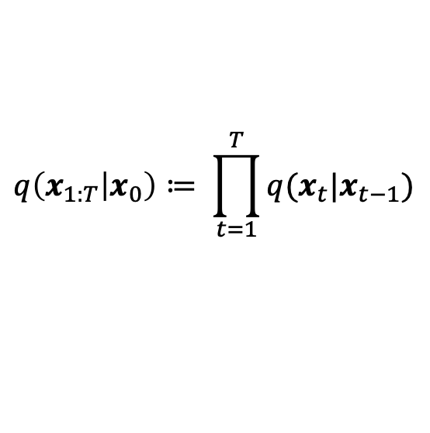
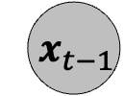

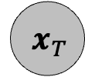
Forward process (noising)
$$x_{T}$$
…
$$x_{t}$$
$$x_{t−1}$$
…
$$x_{0}$$
$$q(x_{t}|x_{t−1})$$
$$q\left(x_{1:T} | x_{0}\right)≔ \prod_{t=1}^{T}{q(x_{t}|x_{t−1})}$$
1) Markov chain
2) Gaussian random vectors
$$q\left(x_{t} | x_{t−1}\right)≔ 𝒩(x_{t};\sqrt{1−β_{t}}x_{t−1},β_{t}I)$$
Variance schedule $β_{1}, ⋯,β_{T}$ controls adding noise
Image credit: https://huggingface.co/blog/annotated-diffusion
Notes:
Reverse process which we've just seen learns to decode from the latent variables, or in other words denoises.
In contrast, forward process defines the latent variables of DDPM, or in other words adds noise into the data.
Just like the reverse process, forward process is also modeled as a Markov chain, where each transition is modeled by Gaussian. There is a deeper background on why forward and backward can be both Markov Gaussian, but that will be covered more in the next lecture.
The forward process q(x_t | x_{t-1}) is defined by a Gaussian with mean ~~ and variance ~~. Notice the \beta_t which controls the mean and variance. As you can see, if beta_t=1, q becomes a pure standard Gaussian whereas if beta_t=0, q becomes a x_t-1 without any variance. Therefore, we can say that \beta_t controls the level of noise.

Slide 12
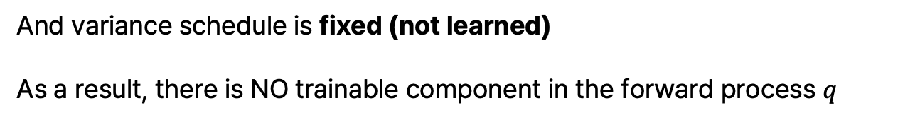
Forward process is NOT trained
$$x_{T}$$
…
$$x_{t}$$
$$x_{t−1}$$
…
$$x_{0}$$
$$q(x_{t}|x_{t−1})$$
$$q\left(x_{1:T} | x_{0}\right)≔ \prod_{t=1}^{T}{q(x_{t}|x_{t−1})}$$
1) Markov chain
2) Gaussian random vectors
$$q\left(x_{t} | x_{t−1}\right)≔ 𝒩(x_{t};\sqrt{1−β_{t}}x_{t−1},β_{t}I)$$
Variance schedule $β_{1}, ⋯,β_{T}$ controls adding noise
And variance schedule is fixed (not learned)
As a result, there is NO trainable component in the forward process $q$
Image credit: https://huggingface.co/blog/annotated-diffusion
Notes:
An important characteristic of DDPM is that this variance schedule is fixed, not learned. As a result, there is NO trainable component in the forward process $q$.
This is in contrast to generative models like VAE where the latent encoder q also contains learnable parameters.

Slide 13
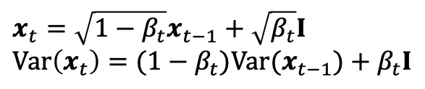
Forward process (noising)
$$x_{T}$$
…
$$x_{t}$$
$$x_{t−1}$$
…
$$x_{0}$$
$$q(x_{t}|x_{t−1})$$
$$q\left(x_{1:T} | x_{0}\right)≔ \prod_{t=1}^{T}{q(x_{t}|x_{t−1})}$$
1) Markov chain
2) Gaussian random vectors
$$q\left(x_{t} | x_{t−1}\right)≔ 𝒩(x_{t};\sqrt{1−β_{t}}x_{t−1},β_{t}I)$$
$$x_{t}=\sqrt{1−β_{t}}x_{t−1}+\sqrt{β_{t}}I \\ Var\left(x_{t}\right)=(1−β_{t})Var(x_{t−1})+β_{t}I$$
Variance preserving: If $Var\left(x_{t−1}\right)=I, Var\left(x_{t}\right)=\left(1−β_{t}\right)I+β_{t}I=I$
Image credit: https://huggingface.co/blog/annotated-diffusion
Notes:
Another important characteristic of DDPM is a so-called variance preserving property. This means that if Var(x_t-1) = I, then also the Var(x_t)=I.
Later in this talk, you will see how we normalize the images, so the pixels, to align with the standard Gaussian. This makes x_0 to have variance somewhat close to I.
Then due to this variance preserving property, the variance of x_t is preserverd to be near-Identity throughout the timesteps. This helps the stable training of DDPM.
This variance-preserving property will also be revisited in the next lecture, where we analyze the DDPM through the lens of DE.

Slide 14





DDPM admits sampling at an arbitrary timestep
$$q\left(x_{t} | x_{t−1}\right)≔ 𝒩(x_{t};\sqrt{1−β_{t}}x_{t−1},β_{t}I)$$
Definition of forward process
$$q\left(x_{t} | x_{0}\right)=𝒩\left(x_{t}; \sqrt{\overline{α_{t}}}x_{0},\left(1−\overline{α_{t}}\right)I\right), α_{t}≔1−β_{t}, \overline{α_{t}}≔Π_{s=1}^{t}α_{s}$$
Derivation from definition
$$x_{T}$$
…
$$x_{t}$$
$$x_{t−1}$$
…
$$x_{0}$$
$$q\left(x_{t} | x_{0}\right)$$
Image credit: https://huggingface.co/blog/annotated-diffusion
Notes:
A crucial property of DDPM is that it admits sampling from an arbitrary timestep. Even though we defined q as a density of x_t given x_t-1, q(x_t|x_0) can be derived in a closed-form formula.
(Explain the formula).

Slide 15
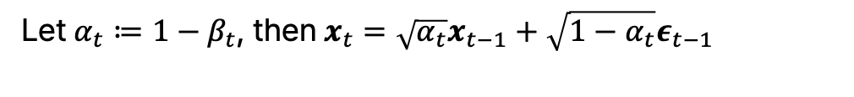
$$Given q\left(x_{t} | x_{t−1}\right)≔ 𝒩\left(x_{t};\sqrt{1−β_{t}}x_{t−1},β_{t}I\right),$$
$$show that q\left(x_{t} | x_{0}\right)=𝒩\left(x_{t}; \sqrt{\overline{α_{t}}}x_{0},\left(1−\overline{α_{t}}\right)I\right), α_{t}≔1−β_{t}, \overline{α_{t}}≔Π_{s=1}^{t}α_{s}$$
$$x_{t}=\sqrt{1−β_{t}}x_{t−1}+\sqrt{β_{t}}ε_{t−1}, ε_{t−1}∼𝒩\left(0,I\right)$$
Let $α_{t}≔1−β_{t}$, then $x_{t}=\sqrt{α_{t}}x_{t−1}+\sqrt{1−α_{t}}ε_{t−1}$
$$x_{t}=\sqrt{α_{t}}\left(\sqrt{α_{t−1}}x_{t−2}+\sqrt{1−α_{t−1}}ε_{t−2}\right)+\sqrt{1−α_{t}}ε_{t−1}$$
$$=\sqrt{α_{t}α_{t−1}}x_{t−2}+\sqrt{α_{t}\left(1−α_{t−1}\right)}ε_{t−2}+\sqrt{1−α_{t}}ε_{t−1}$$
Remember the Markov property, $ε_{t−2 }⊥$ $ε_{t−1}$
Let $\tilde{ε_{t}}=\sqrt{α_{t}\left(1−α_{t−1}\right)}ε_{t−2}+\sqrt{1−α_{t}}ε_{t−1}$ then $\tilde{ε_{t}}∼𝒩\left(0,α_{t}\left(1−α_{t−1}\right)+1−α_{t}\right)=𝒩\left(0,1−α_{t}α_{t−1}\right)$
Now recursively, $x_{t}=\sqrt{α_{t}α_{t−1}⋯α_{1}}x_{0}+\sqrt{1−α_{t}α_{t−1}α_{1}}ε, ε∼$ $𝒩(0,I)$
$$∴ q\left(x_{t} | x_{0}\right)=𝒩\left(x_{t}; \sqrt{\overline{α_{t}}}x_{0},\left(1−\overline{α_{t}}\right)I\right)$$
Notes:
This closed-form formula for q(x_t|x_0) can be dervied as follows.
We use the Markov property to assert the independence between eps_t-2 and eps_t-1.

Slide 16
Training and sampling

Slide 17
Recap: Latent variable in DDPM is a Markov chain of random vectors
Latent variable is a (normally-distributed) Markov chain of random vectors
$$p_{θ}(x_{t−1}|x_{t})$$
$$x_{T}$$
…
$$x_{t}$$
$$x_{t−1}$$
…
$$x_{0}$$
$$q(x_{t}|x_{t−1})$$
$$\log{p_{θ}(x_{0}) }=\log{\int_{x_{1:T}}{p_{θ}\left(x_{0},x_{1:T}\right)dx_{1:T}}}$$
$$=log{\int_{x_{1:T}}{p_{θ}\left(x_{0:T}\right)dx_{1:T}}}$$
Image credit: https://huggingface.co/blog/annotated-diffusion

Slide 18
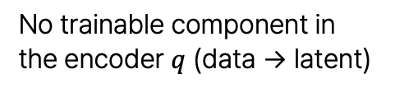
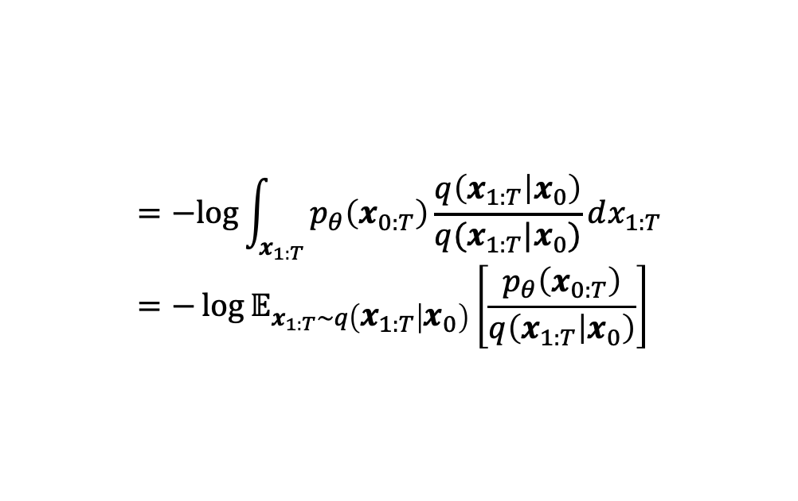
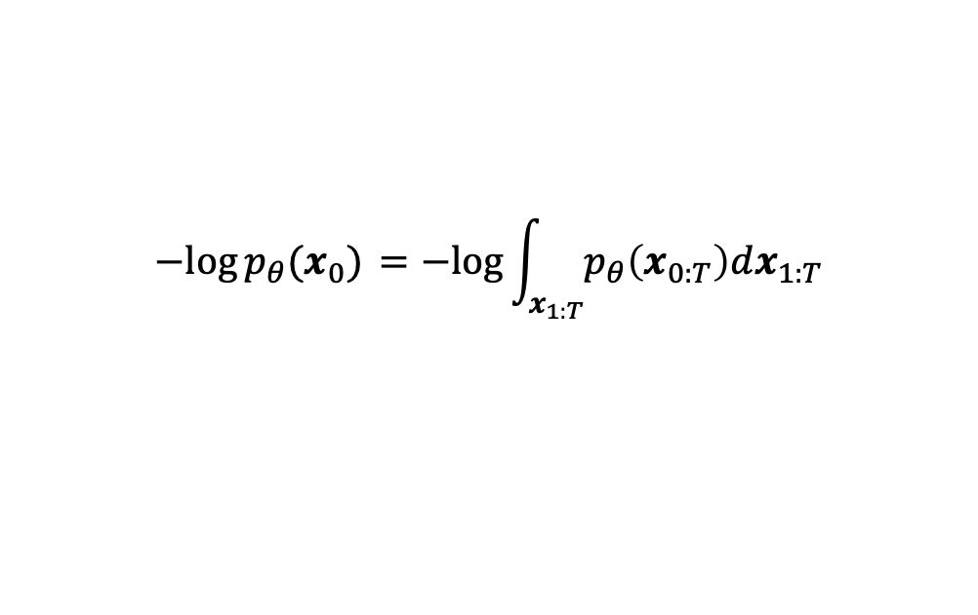
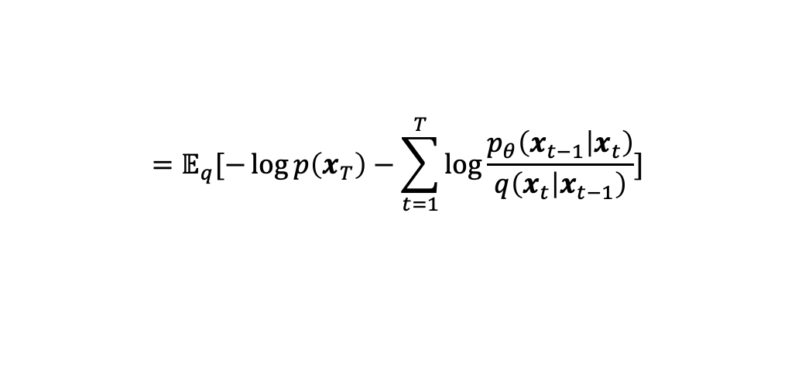

Variational inference in DDPM (just the same)
$$−log{p_{θ}(x_{0}) }=−log{\int_{x_{1:T}}{p_{θ}\left(x_{0:T}\right)dx_{1:T}}}$$
$$=−log{\int_{x_{1:T}}{p_{θ}\left(x_{0:T}\right)\frac{q\left(x_{1:T} | x_{0}\right)}{q(x_{1:T}|x_{0})}dx_{1:T}}} \\ =−{\log{𝔼}}_{x_{1:T}∼q\left(x_{1:T} | x_{0}\right)}\left[\frac{p_{θ}\left(x_{0:T}\right)}{q\left(x_{1:T} | x_{0}\right)}\right]$$
No trainable component in
the encoder $q$ (data → latent)
$$≤ 𝔼_{q}[−\log{\frac{p_{θ}\left(x_{0:T}\right)}{q\left(x_{1:T} | x_{0}\right)}]}$$
$$=𝔼_{q}[−\log{p\left(x_{T}\right)−\sum_{t=1}^{T}{\log{\frac{p_{θ}\left(x_{t−1} | x_{t}\right)}{q\left(x_{t} | x_{t−1}\right)}}}]}$$
Remember the Markov property
Notes:
DDPM uses variational inference, just like VAE. The overall logic is the same, but there are few noticable changes. First, you could find that there is no subscript for model parameter in q. This is because we have defined the forward process without any learable component. And in the last line, p and q is decomposed via the Markov property.

Slide 19
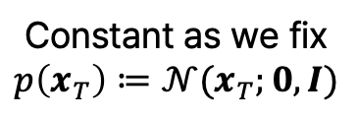
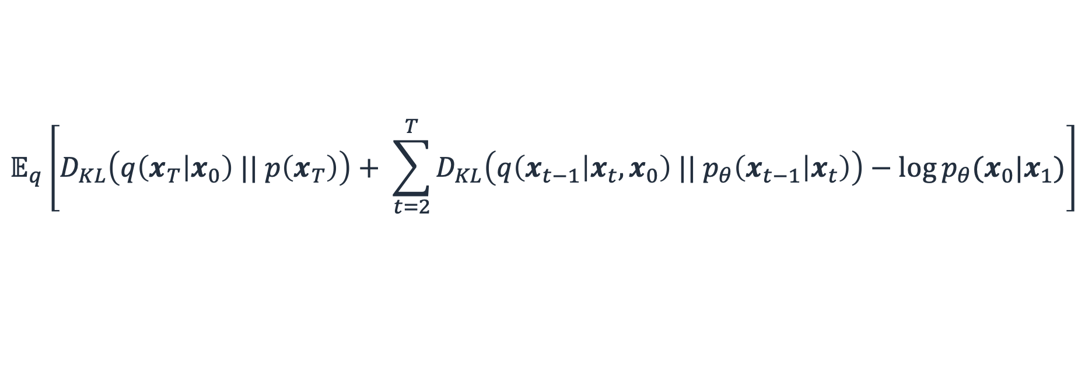
Loss function from variational inference
$$𝔼_{q}\left[D_{KL}\left(q\left(x_{T} | x_{0}\right) || p\left(x_{T}\right)\right)+ \sum_{t=2}^{T}{D_{KL}\left(q\left(x_{t−1} | x_{t},x_{0}\right) || p_{θ}\left(x_{t−1} | x_{t}\right)\right)}−\log{p_{θ}(x_{0}|x_{1})}\right]$$
Constant as we fix
$$p\left(x_{T}\right)≔𝒩(x_{T};0,I)$$
KL divergence between
the forward posterior and the model
Later incorporated into
the left term
Notes:
Skipping to conluson, the loss you see here is the result from variational inference, which we will optimize the model on.
The first term is a KL divergence between ~~ and ~~. However, there is no need to include this in the loss because there is no trainable component here.
The next term with the Sigma is the core term in this loss, which we will dive deeper from now on. The last term also can be incorporated into this term, which we will discusss later on.

Slide 20
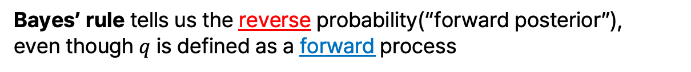
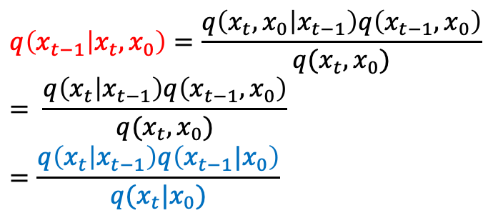
Loss function from variational inference
$$𝔼_{q}\left[D_{KL}\left(q\left(x_{T} | x_{0}\right) || p\left(x_{T}\right)\right)+ \sum_{t=2}^{T}{D_{KL}\left(q\left(x_{t−1} | x_{t},x_{0}\right) || p_{θ}\left(x_{t−1} | x_{t}\right)\right)}−\log{p_{θ}(x_{0}|x_{1})}\right]$$
KL divergence between
the forward posterior and the model
$$q\left(x_{t−1} | x_{t},x_{0}\right)=\frac{q\left(x_{t},x_{0} | x_{t−1}\right)q\left(x_{t−1},x_{0}\right)}{q(x_{t},x_{0})} \\ = \frac{q\left(x_{t} | x_{t−1}\right)q\left(x_{t−1},x_{0}\right)}{q(x_{t},x_{0})} \\ =\frac{q\left(x_{t} | x_{t−1}\right)q\left(x_{t−1}|x_{0}\right)}{q(x_{t}|x_{0})}$$
Bayes’ rule tells us the reverse probability(“forward posterior”),
even though $q$ is defined as a forward process
Notes:
Before seeing how this loss is derived from variational inference, let’s first break down the second term. We have the modeled density p_theta and a sort of a ground truth from q. But remember q is defined as a forward process, from t-1 to t. How can we know the density of t-1 given t from this q? The answer is the Bayes rule. The Bayes’ rule tells us the reverse probability(“forward posterior”),
even though $q$ is defined as a forward process. (Explain briefly.)

Slide 21
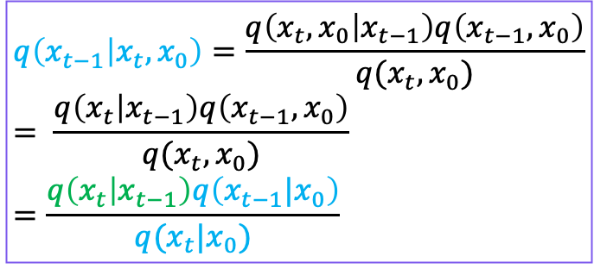
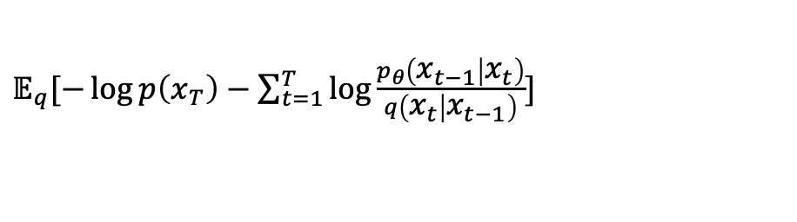
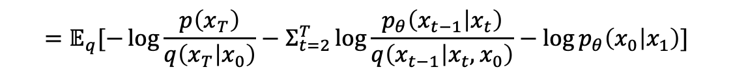
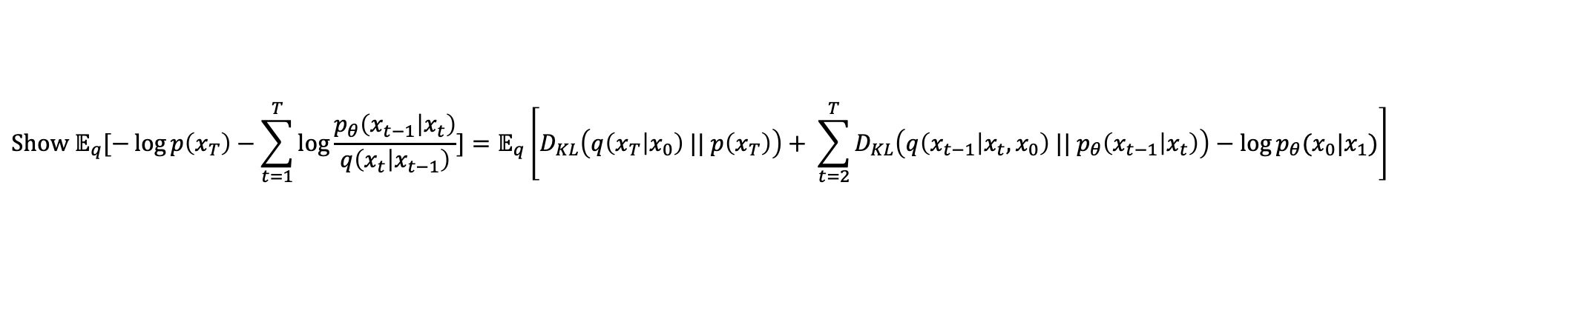
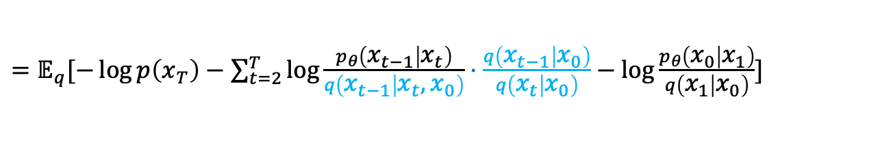
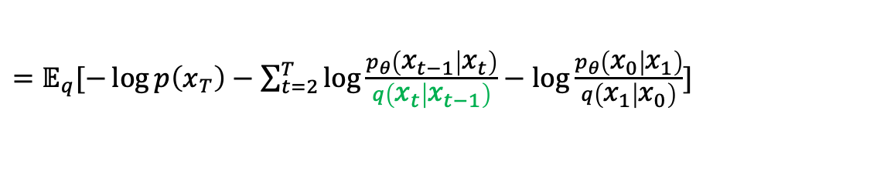
$$Show 𝔼_{q}[−\log{p\left(x_{T}\right)−\sum_{t=1}^{T}{\log{\frac{p_{θ}\left(x_{t−1} | x_{t}\right)}{q\left(x_{t} | x_{t−1}\right)}}}]}=𝔼_{q}\left[D_{KL}\left(q\left(x_{T} | x_{0}\right) || p\left(x_{T}\right)\right)+ \sum_{t=2}^{T}{D_{KL}\left(q\left(x_{t−1} | x_{t},x_{0}\right) || p_{θ}\left(x_{t−1} | x_{t}\right)\right)}−\log{p_{θ}(x_{0}|x_{1})}\right]$$
$$q\left(x_{t−1} | x_{t},x_{0}\right)=\frac{q\left(x_{t},x_{0} | x_{t−1}\right)q\left(x_{t−1},x_{0}\right)}{q(x_{t},x_{0})} \\ = \frac{q\left(x_{t} | x_{t−1}\right)q\left(x_{t−1},x_{0}\right)}{q(x_{t},x_{0})} \\ =\frac{q\left(x_{t} | x_{t−1}\right)q\left(x_{t−1}|x_{0}\right)}{q(x_{t}|x_{0})}$$
$𝔼_{q}[−\log{p\left(x_{T}\right)−\sum_{t=1}^{T}{\log{\frac{p_{θ}\left(x_{t−1} | x_{t}\right)}{q\left(x_{t} | x_{t−1}\right)}}}]}$
$=𝔼_{q}[−\log{p\left(x_{T}\right)−\sum_{t=2}^{T}{\log{\frac{p_{θ}\left(x_{t−1} | x_{t}\right)}{q\left(x_{t} | x_{t−1}\right)}}−\log{\frac{p_{θ}\left(x_{0} | x_{1}\right)}{q\left(x_{1} | x_{0}\right)}}}]}$
$=𝔼_{q}[−\log{p\left(x_{T}\right)−\sum_{t=2}^{T}{\log{\frac{p_{θ}\left(x_{t−1} | x_{t}\right)}{q\left(x_{t−1} | x_{t},x_{0}\right)}⋅\frac{q\left(x_{t−1} | x_{0}\right)}{q\left(x_{t} | x_{0}\right)}}−\log{\frac{p_{θ}\left(x_{0} | x_{1}\right)}{q\left(x_{1} | x_{0}\right)}}}]}$
Forward posterior
$$=𝔼_{q}[−\log{p\left(x_{T}\right)−Σ_{t=2}^{T}\log{\frac{p_{θ}\left(x_{t−1} | x_{t}\right)}{q\left(x_{t−1} | x_{t},x_{0}\right)}}−\log{\frac{q\left(x_{1} | x_{0}\right)}{q\left(x_{T} | x_{0}\right)}}−\log{\frac{p_{θ}\left(x_{0} | x_{1}\right)}{q\left(x_{1} | x_{0}\right)}}]}$$
$$=𝔼_{q}[−\log{\frac{p\left(x_{T}\right)}{q\left(x_{T} | x_{0}\right)}−Σ_{t=2}^{T}\log{\frac{p_{θ}\left(x_{t−1} | x_{t}\right)}{q\left(x_{t−1} | x_{t},x_{0}\right)}−\log{p_{θ}\left(x_{0} | x_{1}\right)}}]}$$
$$=𝔼_{q}\left[D_{KL}\left(q\left(x_{T} | x_{0}\right) || p\left(x_{T}\right)\right)+{Σ_{t=2}^{T} D}_{KL}\left(q\left(x_{t−1} | x_{t},x_{0}\right) || p_{θ}\left(x_{t−1} | x_{t}\right)\right)−\log{p_{θ}(x_{0}|x_{1})}\right]$$
Notes:
Now we will see how this loss is derived from variational inference.

Slide 22



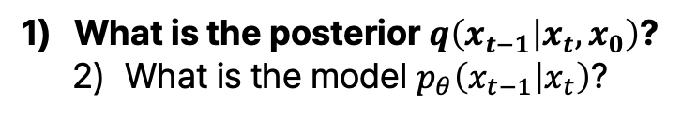
Loss function from variational inference
$$𝔼_{q}\left[D_{KL}\left(q\left(x_{T} | x_{0}\right) || p\left(x_{T}\right)\right)+ \sum_{t=2}^{T}{D_{KL}\left(q\left(x_{t−1} | x_{t},x_{0}\right) || p_{θ}\left(x_{t−1} | x_{t}\right)\right)}−\log{p_{θ}(x_{0}|x_{1})}\right]$$
$$L_{T}$$
$$L_{t−1}$$
$$L_{0}$$
KL divergence between
the forward posterior and the model
What is the posterior $q\left(x_{t−1} | x_{t},x_{0}\right)$?
What is the model $p_{θ}\left(x_{t−1} | x_{t}\right)$?
Notes:
Back to the loss, now we will see how to calculate the second term, the core term of DDPM loss. There are two components in this KL divergence, which we should both know. First is the posterior and second is the model density. Let’s first see the posterior.

Slide 23
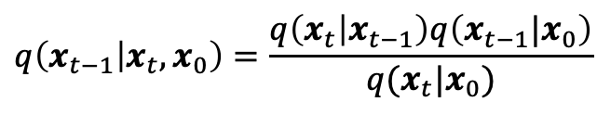
Let’s get posterior $q\left(x_{t−1} | x_{t},x_{0}\right)$. We already know the following three.
$$q\left(x_{t} | x_{t−1}\right)≔ 𝒩(x_{t};\sqrt{1−β_{t}}x_{t−1},β_{t}I)$$
Definition of forward process
$$q\left(x_{t} | x_{0}\right)=𝒩\left(x_{t}; \sqrt{\overline{α_{t}}}x_{0},\left(1−\overline{α_{t}}\right)I\right), α_{t}≔1−β_{t}, \overline{α_{t}}≔Π_{s=1}^{t}α_{s}$$
Derivation from definition
$$q\left(x_{t−1} | x_{t},x_{0}\right)=\frac{q\left(x_{t} | x_{t−1}\right)q\left(x_{t−1}|x_{0}\right)}{q(x_{t}|x_{0})}$$
Bayes theorem + Markov property
Ignoring the normalization constant, $q\left(x_{t−1} | x_{t},x_{0}\right)∝q\left(x_{t} | x_{t−1}\right)q\left(x_{t−1}|x_{0}\right)$
Without showing, we use that the product of two isotropic Gaussian densities is still an isotropic Gaussian density.
Let $q\left(x_{t−1} | x_{t},x_{0}\right)∼𝒩\left({\tilde{μ}}_{t},\tilde{β_{t}}I\right)$
Notes:
As mentioned earlier, this q is derived from the Bayes rule.

Slide 24

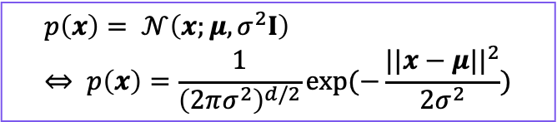
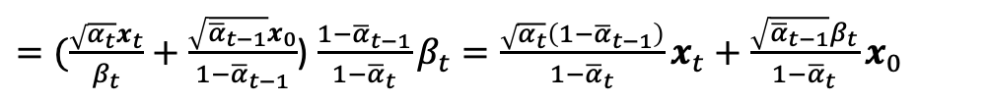
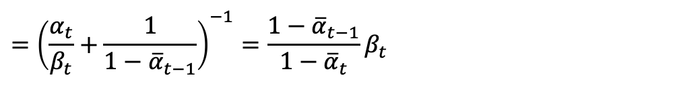

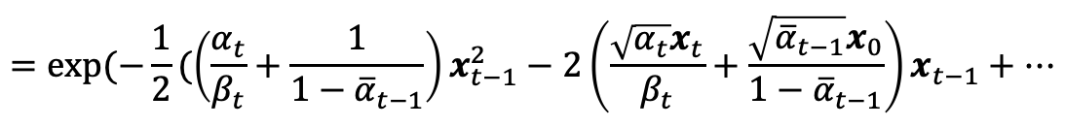



Density of isotropic Gaussian
$$p\left(x\right)= 𝒩\left(x;μ,σ^{2}I\right) \\ ⇔ p\left(x\right)=\frac{1}{{\left(2πσ^{2}\right)}^{d/2}}\exp{(−\frac{||x−μ||^{2}}{2σ^{2}}})$$
Let’s get posterior $q\left(x_{t−1} | x_{t},x_{0}\right)$
$$q\left(x_{t} | x_{t−1}\right)≔ 𝒩(x_{t};\sqrt{1−β_{t}}x_{t−1},β_{t}I)$$
$$q\left(x_{t} | x_{0}\right)=𝒩\left(x_{t}; \sqrt{\overline{α_{t}}}x_{0},\left(1−\overline{α_{t}}\right)I\right), α_{t}≔1−β_{t}, \overline{α_{t}}≔Π_{s=1}^{t}α_{s}$$
$$q\left(x_{t−1} | x_{t},x_{0}\right)∝q\left(x_{t} | x_{t−1}\right)q\left(x_{t−1}|x_{0}\right)$$
Let $q\left(x_{t−1} | x_{t},x_{0}\right)∼𝒩\left({\tilde{μ}}_{t},\tilde{β_{t}}I\right)$
$$q\left(x_{t−1} | x_{t},x_{0}\right)∝q\left(x_{t} | x_{t−1}\right)q\left(x_{t−1}|x_{0}\right)∝exp\left(−\frac{1}{2β_{t}}||x_{t}−\sqrt{α_{t}}x_{t−1}||^{2}\right)×\exp{(−\frac{1}{2\left(1−{\overline{α}}_{t−1}\right)}||x_{t−1}−\sqrt{{\overline{α}}_{t−1}}x_{0}||^{2})}$$
$$=\exp{(−\frac{1}{2}(\left(\frac{α_{t}}{β_{t}}+\frac{1}{1−{\overline{α}}_{t−1}}\right)x_{t−1}^{2}−2\left(\frac{\sqrt{α_{t}}x_{t}}{β_{t}}+\frac{\sqrt{{\overline{α}}_{t−1}}x_{0}}{1−{\overline{α}}_{t−1}}\right)x_{t−1}+⋯}$$
$$={\left(\frac{α_{t}}{β_{t}}+\frac{1}{1−{\overline{α}}_{t−1}}\right)}^{−1}=\frac{{1−\overline{α}}_{t−1}}{1−{\overline{α}}_{t}}β_{t}$$
$${\tilde{β}}_{t}=$$
$$−1$$
$${\tilde{μ}}_{t}=$$
$=(\frac{\sqrt{α_{t}}x_{t}}{β_{t}}+\frac{\sqrt{{\overline{α}}_{t−1}}x_{0}}{1−{\overline{α}}_{t−1}}$) $\frac{{1−\overline{α}}_{t−1}}{1−{\overline{α}}_{t}}β_{t}=\frac{\sqrt{α_{t}}\left(1−{\overline{α}}_{t−1}\right)}{1−{\overline{α}}_{t}}x_{t}+\frac{\sqrt{{\overline{α}}_{t−1}}β_{t}}{1−{\overline{α}}_{t}}x_{0}$

Slide 25
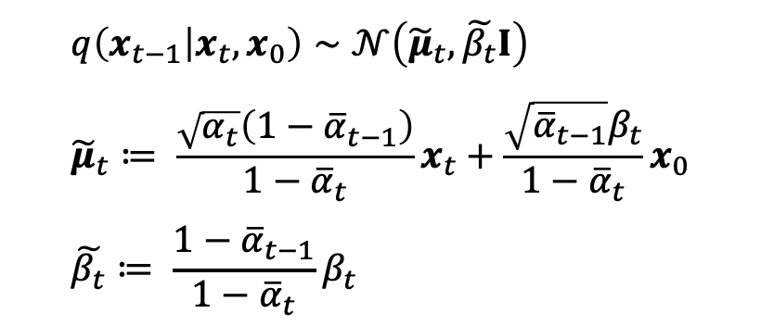
Now we have the closed-form solution of the posterior $q\left(x_{t−1} | x_{t},x_{0}\right)$
$$q\left(x_{t−1} | x_{t},x_{0}\right)∼𝒩\left({\tilde{μ}}_{t},\tilde{β_{t}}I\right) \\ {\tilde{μ}}_{t}≔ \frac{\sqrt{α_{t}}\left(1−{\overline{α}}_{t−1}\right)}{1−{\overline{α}}_{t}}x_{t}+\frac{\sqrt{{\overline{α}}_{t−1}}β_{t}}{1−{\overline{α}}_{t}}x_{0} \\ \tilde{β_{t}}≔ \frac{{1−\overline{α}}_{t−1}}{1−{\overline{α}}_{t}}β_{t}$$
1) Forward posterior is also an isotropic Gaussian
2) Its mean ${\tilde{μ}}_{t}$is a mixture of $x_{t}$ and $x_{0}$according to the variance schedule
Notes:
Now we have the final close—form posterior of q(x_t-1 given …). Two things you should remember here is that
Forward posterior is also an istropic Gaussian.
Its mean mu tilde t is a mixture of x_t and x_0 according to the variance schedule

Slide 26
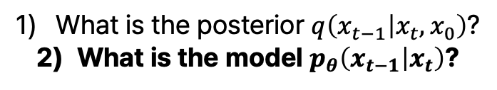
Loss function from variational inference
$$𝔼_{q}\left[D_{KL}\left(q\left(x_{T} | x_{0}\right) || p\left(x_{T}\right)\right)+ \sum_{t=2}^{T}{D_{KL}\left(q\left(x_{t−1} | x_{t},x_{0}\right) || p_{θ}\left(x_{t−1} | x_{t}\right)\right)}−\log{p_{θ}(x_{0}|x_{1})}\right]$$
$$L_{T}$$
$$L_{t−1}$$
$$L_{0}$$
KL divergence between
the forward posterior and the model
What is the posterior $q\left(x_{t−1} | x_{t},x_{0}\right)$?
What is the model $p_{θ}\left(x_{t−1} | x_{t}\right)$?
Notes:
Now let’s see what is the model p theta

Slide 27
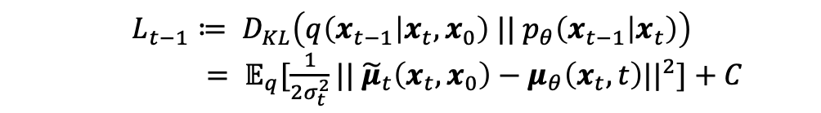

Recall that $p_{θ}\left(x_{t−1} | x_{t}\right)$ is defined as a Gaussian density.
$$p_{θ}\left(x_{t−1} | x_{t}\right)≔ 𝒩(x_{t−1},μ_{θ}\left(x_{t}, t\right),Σ_{θ}\left(x_{t},t\right))$$
In DDPM, we fix $Σ_{θ}\left(x_{t},t\right)$ as an untrained time-dependent constant $σ_{t}^{2}I$.
$p_{θ}\left(x_{t−1} | x_{t}\right)≔ 𝒩(x_{t−1},μ_{θ}\left(x_{t}, t\right),σ_{t}^{2}I$)
Now we can simplify KL divergence between two isotropic Gaussians as a L2 distance between their mean.
$$L_{t−1}≔ D_{KL}\left(q\left(x_{t−1} | x_{t},x_{0}\right) || p_{θ}\left(x_{t−1} | x_{t}\right)\right)$$
$= 𝔼_{q}[\frac{1}{2σ_{t}^{2}}||$ ${\tilde{μ}}_{t}\left(x_{t},x_{0}\right)−μ_{θ}\left(x_{t},t\right)||^{2}]+C$
forward posterior
model
Notes:
As we’ve seen in the first slides, we define this p_theta, the reverse process to be Gaussian. Modeling Gaussian means modeling the mean and the variance. But in DDPM, we fix the variance as an untrained time-dependent constant sigma^2I. So the variance of p_theta is fixed as some sigma_t, not trained. This sigma_t is largely a design choice, which we will see more in the last section. Now that we’ve fixed the variance, the KL divergence between two isotropic Gaussian becomes a L2 distance between their mean. We will omit a detailed proof here.

Slide 28
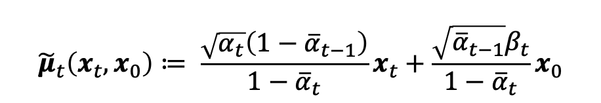
Motivation for reparameterization
$L_{t−1}≔ D_{KL}\left(q\left(x_{t−1} | x_{t},x_{0}\right) || p_{θ}\left(x_{t−1} | x_{t}\right)\right)= 𝔼_{q}[\frac{1}{2σ_{t}^{2}}||$ ${\tilde{μ}}_{t}\left(x_{t},x_{0}\right)−μ_{θ}\left(x_{t},t\right)||^{2}]+C$
$${\tilde{μ}}_{t}\left(x_{t},x_{0}\right)≔ \frac{\sqrt{α_{t}}\left(1−{\overline{α}}_{t−1}\right)}{1−{\overline{α}}_{t}}x_{t}+\frac{\sqrt{{\overline{α}}_{t−1}}β_{t}}{1−{\overline{α}}_{t}}x_{0}$$
1) Directly approximating
the mean is possible
$μ_{θ}\left(x_{t},t\right)≔$??
Notes:
If you could recall, the mean of posterior is given in a closed form, as a mixture of x_t and x_0. But how do we model the model mean this with mu_theta? Simple and naïve solution is building a neural network that recieves x_t and t as input and outputs mu_theta, the estimate for mu tilde t. However, this turns out to be a kind of dumb approach.

Slide 29
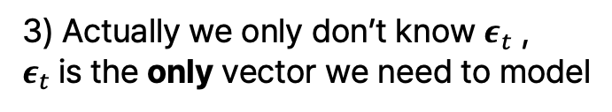

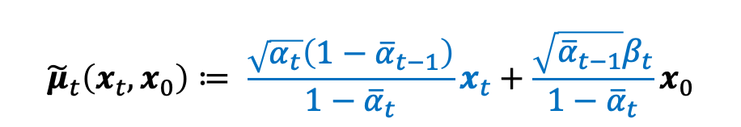
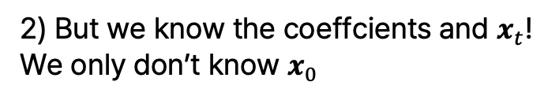
Motivation for reparameterization
$L_{t−1}≔ D_{KL}\left(q\left(x_{t−1} | x_{t},x_{0}\right) || p_{θ}\left(x_{t−1} | x_{t}\right)\right)= 𝔼_{q}[\frac{1}{2σ_{t}^{2}}||$ ${\tilde{μ}}_{t}\left(x_{t},x_{0}\right)−μ_{θ}\left(x_{t},t\right)||^{2}]+C$
$${\tilde{μ}}_{t}\left(x_{t},x_{0}\right)≔ \frac{\sqrt{α_{t}}\left(1−{\overline{α}}_{t−1}\right)}{1−{\overline{α}}_{t}}x_{t}+\frac{\sqrt{{\overline{α}}_{t−1}}β_{t}}{1−{\overline{α}}_{t}}x_{0}$$
1) Directly approximating
the mean is possible
2) But we know the coeffcients and $x_{t}$!
We only don’t know $x_{0}$
$μ_{θ}\left(x_{t},t\right)≔$??
$$q\left(x_{t} | x_{0}\right)=𝒩\left(x_{t}; \sqrt{\overline{α_{t}}}x_{0},\left(1−\overline{α_{t}}\right)I\right), α_{t}≔1−β_{t}, \overline{α_{t}}≔Π_{s=1}^{t}α_{s}$$
$x_{t}=$ $\sqrt{\overline{α_{t}}}x_{0}+\sqrt{\left(1−\overline{α_{t}}\right)}ε_{t}, ε_{t}∼ 𝒩\left(0,I\right)$
$∴x_{0}=\frac{1}{\sqrt{{\overline{α}}_{t}}}(x_{t}−$ $\sqrt{\left(1−\overline{α_{t}}\right)}ε_{t}$)
3) Actually we only don’t know $ε_{t}$ ,
$ε_{t}$is the only vector we need to model
Notes:
This is because we already know a lot of parts of u tilde t. As the variance schedule beta and its complement alpha is fixed starting from training, we know the coefficients of x_t and x_0. And furthermore, we already know the x_t. This only leaves us with x_0. x_0 is the only unknown.
And actually, we can go more from x_0. Remember how x_t can be given as a closed-form formula given x_0? By reversing this formula, we can get x_0 from x_t in a closed-form solution. Through reparametrizaiotn, we isolate the randomness of x_t into eps_t. Then x_0 is given as ~~ where we only don’t know the eps_t.

Slide 30
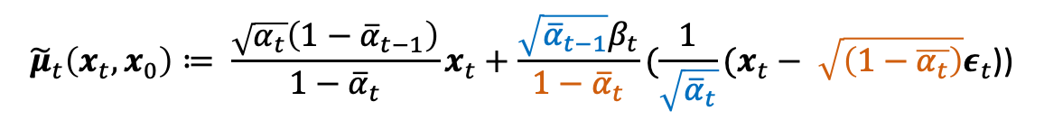






$$α_{t}≔1−β_{t}, \overline{α_{t}}≔Π_{s=1}^{t}α_{s}$$
Let’s reparametrize ${\tilde{μ}}_{t}\left(x_{t},x_{0}\right)$ to ${\tilde{μ}}_{t}\left(x_{t},ε_{t}\right)$
$${\tilde{μ}}_{t}\left(x_{t},x_{0}\right)≔ \frac{\sqrt{α_{t}}\left(1−{\overline{α}}_{t−1}\right)}{1−{\overline{α}}_{t}}x_{t}+\frac{\sqrt{{\overline{α}}_{t−1}}β_{t}}{1−{\overline{α}}_{t}}(\frac{1}{\sqrt{{\overline{α}}_{t}}}(x_{t}− \sqrt{\left(1−\overline{α_{t}}\right)}ε_{t}\text{)}\text{)}$$
$$=\frac{\sqrt{α_{t}{\overline{α}}_{t}}\left(1−{\overline{α}}_{t−1}\right)+\sqrt{{\overline{α}}_{t−1}}β_{t}}{(1−{\overline{α}}_{t})\sqrt{{\overline{α}}_{t}}}x_{t}−\frac{β_{t}}{\sqrt{1−\overline{α_{t}}}\sqrt{α_{t}}}ε_{t}$$
$$=\frac{α_{t}\sqrt{{\overline{α}}_{t−1}}\left(1−{\overline{α}}_{t−1}\right)+\sqrt{{\overline{α}}_{t−1}}β_{t}}{(1−{\overline{α}}_{t})\sqrt{{\overline{α}}_{t}}}x_{t}−\frac{β_{t}}{\sqrt{1−\overline{α_{t}}}\sqrt{α_{t}}}ε_{t}$$
$$=\frac{\sqrt{{\overline{α}}_{t−1}}{(α_{t}+β}_{t}−{\overline{α}}_{t})}{(1−{\overline{α}}_{t})\sqrt{{\overline{α}}_{t}}}x_{t}−\frac{β_{t}}{\sqrt{1−\overline{α_{t}}}\sqrt{α_{t}}}ε_{t}$$
$$=\frac{1}{\sqrt{α_{t}}}x_{t}−\frac{β_{t}}{\sqrt{1−\overline{α_{t}}}\sqrt{α_{t}}}ε_{t}$$
$$=\frac{1}{\sqrt{α_{t}}}\left(x_{t}−\frac{β_{t}}{\sqrt{1−\overline{α_{t}}}}ε_{t}\right)≔{\tilde{μ}}_{t}\left(x_{t},ε_{t}\right)$$
We know
We do not know
Notes:
Now let’s combine the formula for posterior and formula for relationship between x_0 and (x_t and eps_t).
(Explanation).
Now we’ve reparametrized the formula for posterior mean as a function of x_t and eps_t, not x_t and x_0. As explained below, this is a better parametriziation as it clearly breaks down the posterior mean into x_t, which we surley know and x_0, which we never know,

Slide 31

The model only needs to learn the epsilon, the noise at timestep t.
$${\tilde{μ}}_{t}\left(x_{t},ε_{t}\right)=\frac{1}{\sqrt{α_{t}}}\left(x_{t}−\frac{β_{t}}{\sqrt{1−\overline{α_{t}}}}ε_{t}\right) \\ μ_{θ}\left(x_{t},t\right)=\frac{1}{\sqrt{α_{t}}}\left(x_{t}−\frac{β_{t}}{\sqrt{1−\overline{α_{t}}}}ε_{θ}(x_{t},t)\right)$$
Notes:
As we’ve isolated the unknown of posterior mean to eps_t, we only need to model this eps_t. The modeled eps_t will now be called as eps_theta.

Slide 32




Plug in reparametrized $\tilde{μ_{t}}\left(x_{t},ε_{t}\right)$ into $L_{t−1}$
$L_{t−1}≔ D_{KL}\left(q\left(x_{t−1} | x_{t},x_{0}\right) || p_{θ}\left(x_{t−1} | x_{t}\right)\right)= 𝔼_{q}[\frac{1}{2σ_{t}^{2}}||$ ${\tilde{μ}}_{t}\left(x_{t},x_{0}\right)−μ_{θ}\left(x_{t},t\right)||^{2}]+C$
$${\tilde{μ}}_{t}\left(x_{t},ε_{t}\right)=\frac{1}{\sqrt{α_{t}}}(x_{t}−\frac{β_{t}}{\sqrt{1−\overline{α_{t}}}}ε_{t})$$
$x_{t}=$ $\sqrt{\overline{α_{t}}}x_{0}+\sqrt{\left(1−\overline{α_{t}}\right)}ε_{t}, ε_{t}∼ 𝒩\left(0,I\right)$
$$L_{t−1}−C=𝔼_{q}\left[\frac{1}{2σ_{t}^{2}}|| {\tilde{μ}}_{t}\left(x_{t},x_{0}\right)−μ_{θ}\left(x_{t},t\right)||^{2}\right]$$
$$=𝔼_{q}\left[\frac{1}{2σ_{t}^{2}}||\frac{1}{\sqrt{α_{t}}}(x_{t}−\frac{β_{t}}{\sqrt{1−\overline{α_{t}}}}ε_{t})−\frac{1}{\sqrt{α_{t}}}(x_{t}−\frac{β_{t}}{\sqrt{1−\overline{α_{t}}}}ε_{θ}(x_{t},t))||^{2}\right]$$
$$=𝔼_{q}\left[\frac{1}{2σ_{t}^{2}}||\frac{β_{t}}{\sqrt{α_{t}\left(1−{\overline{α}}_{t}\right)}}(ε_{t}−ε_{θ}(x_{t},t))||^{2}\right]$$
$$=𝔼_{q}\left[\frac{β_{t}^{2}}{2σ_{t}^{2}α_{t}\left(1−{\overline{α}}_{t}\right)}|| (ε_{t}−ε_{θ}(x_{t},t))||^{2}\right]$$
Notes:
Recall that our loss term of intereset is a L2 distance between the posterior mean and the model mean. Now that we’ve reprarametrized this mean with x_t and eps_t, this L2 distance of mean turns into the L2 distance between eps, weighted by variance schedule and fixed variance of reverse process.

Slide 33




Sampling standard normal noise is equivalent to sampling latent
$L_{t−1}≔ D_{KL}\left(q\left(x_{t−1} | x_{t},x_{0}\right) || p_{θ}\left(x_{t−1} | x_{t}\right)\right)= 𝔼_{q}[\frac{1}{2σ_{t}^{2}}||$ ${\tilde{μ}}_{t}\left(x_{t},x_{0}\right)−μ_{θ}\left(x_{t},t\right)||^{2}]+C$
$${\tilde{μ}}_{t}\left(x_{t},ε_{t}\right)=\frac{1}{\sqrt{α_{t}}}(x_{t}−\frac{β_{t}}{\sqrt{1−\overline{α_{t}}}}ε_{t})$$
$x_{t}=$ $\sqrt{\overline{α_{t}}}x_{0}+\sqrt{\left(1−\overline{α_{t}}\right)}ε_{t}, ε_{t}∼ 𝒩\left(0,I\right)$
$$L_{t−1}−C \\ =𝔼_{q}\left[\frac{β_{t}^{2}}{2σ_{t}^{2}α_{t}\left(1−{\overline{α}}_{t}\right)}|| (ε_{t}−ε_{θ}(x_{t},t))||^{2}\right]$$
What was $q$?
Recall $x_{1:T}∼q\left(x_{1:T} | x_{0}\right)$
$$=𝔼_{q}\left[\frac{β_{t}^{2}}{2σ_{t}^{2}α_{t}\left(1−{\overline{α}}_{t}\right)}|| (ε_{t}−ε_{θ}(\sqrt{\overline{α_{t}}}x_{0}+\sqrt{\left(1−\overline{α_{t}}\right)}ε_{t}, t))||^{2}\right]$$
$$=𝔼_{ε∼𝓝\left(0,I\right), t}\left[\frac{β_{t}^{2}}{2σ_{t}^{2}α_{t}\left(1−{\overline{α}}_{t}\right)}|| (ε−ε_{θ}(\sqrt{\overline{α_{t}}}x_{0}+\sqrt{\left(1−\overline{α_{t}}\right)}ε, t))||^{2}\right]$$
Also take an expectation over data $x_{0}$
$$𝔼_{x_{0}, ε∼𝓝\left(0,I\right), t}\left[\frac{β_{t}^{2}}{2σ_{t}^{2}α_{t}\left(1−{\overline{α}}_{t}\right)}|| (ε−ε_{θ}(\sqrt{\overline{α_{t}}}x_{0}+\sqrt{\left(1−\overline{α_{t}}\right)}ε, t))||^{2}\right]$$
Notes:
Recall that this expectation in the loss term is an expectation over q. Q basically samples latent from the data x_0, and the only random part in this latent sampling is the eps_t. Noise is always sampled from the standard Gaussian, and the degree of noise is controlled by the variance schedule.
So the noise eps_t is actually not depedent on t. Therefore, we simply drop the t in epsilon and take an expectiation over the standard Gaussian eps.
And obviously we also take an expectation over the data x_0.
Now we get something that is very close to the loss term of DDPM

Slide 34
DDPM uses a simpler variant loss
$$𝔼_{x_{0}, ε∼𝓝\left(0,I\right), t}\left[\frac{β_{t}^{2}}{2σ_{t}^{2}α_{t}\left(1−{\overline{α}}_{t}\right)}|| (ε−ε_{θ}(\sqrt{\overline{α_{t}}}x_{0}+\sqrt{\left(1−\overline{α_{t}}\right)}ε, t))||^{2}\right]$$
$${L_{simple}=𝔼}_{x_{0}, ε∼𝓝\left(0,I\right), t}\left[|| (ε−ε_{θ}(\sqrt{\overline{α_{t}}}x_{0}+\sqrt{\left(1−\overline{α_{t}}\right)}ε, t))||^{2}\right]$$
”Beneficial to sample quality (and simpler to implement)”
Notes:
In DDPM, actually a simpler variant is used for loss. This loss discards all the weighting factor of L2 distance. The authors explains that this is ~~.

Slide 35






DDPM uses a simpler variant loss
$$𝔼_{x_{0}, ε∼𝓝\left(0,I\right), t}\left[\frac{β_{t}^{2}}{2σ_{t}^{2}α_{t}\left(1−{\overline{α}}_{t}\right)}|| (ε−ε_{θ}(\sqrt{\overline{α_{t}}}x_{0}+\sqrt{\left(1−\overline{α_{t}}\right)}ε, t))||^{2}\right]$$
$${L_{simple}=𝔼}_{x_{0}, ε∼𝓝\left(0,I\right), t}\left[|| (ε−ε_{θ}(\sqrt{\overline{α_{t}}}x_{0}+\sqrt{\left(1−\overline{α_{t}}\right)}ε, t))||^{2}\right]$$
”Beneficial to sample quality (and simpler to implement)”
Revisiting $L_{0}$
$$L_{t−1}={𝔼[D}_{KL}\left(q\left(x_{t−1} | x_{t},x_{0}\right) || p_{θ}\left(x_{t−1} | x_{t}\right)\right)]$$
KL divergence between distribution
$$L_{0}=𝔼[−\log{p_{θ}\left(x_{0} | x_{1}\right)}]$$
$x_{0}$ is a fixed data (no stochasticity), while $p_{θ}\left({x_{0}|x}_{1}\right)$ is a distribution.
Let’s compare the data with the mean of $p_{θ}\left({x_{0}|x}_{1}\right)$!
$$𝔼_{x_{0}, ε∼𝓝\left(0,I\right)}\left[|| (ε−ε_{θ}(\sqrt{\overline{α_{1}}}x_{0}+\sqrt{\left(1−\overline{α_{1}}\right)}ε, 1))||^{2}\right] \\ ={C 𝔼}_{x_{0}, ε∼𝓝\left(0,I\right)}\left[|| ({\tilde{μ}}_{1}\left(x_{1},x_{0}\right)−μ_{θ}\left(x_{1},1\right))||^{2}\right] \\ ≈{C 𝔼}_{x_{0}, ε∼𝓝\left(0,I\right)}\left[|| x_{0}−μ_{θ}\left(x_{1},1\right))||^{2}\right]$$
data
mean of $p_{θ}\left({x_{0}|x}_{1}\right)$
Simple loss is the L2 distance between the data and mean, ignoring the constants
Notes:
Now will deal with the last term L_0, which I’ve earlier said that will be corporated into L_t-1. The problem with L_0 is that there is no stochasticity in the ground truth x_0. For all the other x_t’s x_t is given as a density. So we could calculate a KL divergence between this density and modeled density. Howver is there is no such thing as a density of x_0. There is only the single fixed point x_0, which is the true data. Therefore, what we do is effectively calculating the L2 loss of the data and the mean of the modled density. This intutiviely makes sense. The simple loss we’ve seen in the last slide is basically this L2 distance between the data and the mean of modled density, ignoring the constants.

Slide 36





$$𝔼_{x_{0}, ε∼𝓝\left(0,I\right), t}\left[|| (ε−ε_{θ}(\sqrt{\overline{α_{t}}}x_{0}+\sqrt{\left(1−\overline{α_{t}}\right)}ε, t))||^{2}\right]$$
Training DDPM
DDPM learns to denoise from any timestep
$$x_{T}$$
$$x_{t}$$
$$x_{t−1}$$
$$x_{0}$$
Notes:
Now we wrap up the training process of DDPM. As shown in this pseudocode, we take a gradient update step on this loss we derived. Sampling is done on data x_0, timestep t, and the noise eps. This effectively means that DDPM learns to denoise from any timestep. Given the noisy latent x_t at timestep t, it predicts the noise. Predicting the noise means predicting the data, as we can simply subtract the predicted noise from the noisy latent x_t.

Slide 37







Sampling from DDPM
$$p_{θ}\left(x_{t−1} | x_{t}\right)≔ 𝒩(x_{t−1},μ_{θ}\left(x_{t}, t\right),Σ_{θ}\left(x_{t},t\right))$$
$$μ_{θ}\left(x_{t},t\right)=\frac{1}{\sqrt{α_{t}}}\left(x_{t}−\frac{β_{t}}{\sqrt{1−\overline{α_{t}}}}ε_{θ}(x_{t},t)\right)$$
$$Σ_{θ}\left(x_{t},t\right)≔σ_{t}^{2}I$$
DDPM gradually denoises from the prior
$$p_{θ}(x_{t−1}|x_{t})$$
$$x_{T}$$
…
$$x_{t}$$
$$x_{t−1}$$
…
$$x_{0}$$
Notes:
When sampling from the prior, DDPM gradually denoises. The density of next latent x_t-1 is sampled from the density p. This model p consists of the modeled mean and the fixed variance.

Slide 38





Sampling from DDPM
$$p_{θ}\left(x_{t−1} | x_{t}\right)≔ 𝒩(x_{t−1},μ_{θ}\left(x_{t}, t\right),Σ_{θ}\left(x_{t},t\right))$$
$$μ_{θ}\left(x_{t},t\right)=\frac{1}{\sqrt{α_{t}}}\left(x_{t}−\frac{β_{t}}{\sqrt{1−\overline{α_{t}}}}ε_{θ}(x_{t},t)\right)$$
$$Σ_{θ}\left(x_{t},t\right)≔σ_{t}^{2}I$$
In principle, $x_{0}$ can be generated from any timestep
$${\hat{x}}_{0}=\frac{1}{\sqrt{α_{t}}}(x_{t}−\sqrt{1−{\overline{α}}_{t}}ε_{θ}\left(x_{t},t\right))$$
$$x_{T}$$
$$x_{t}$$
$$x_{t−1}$$
$$x_{0}$$
Notes:
One noticable thing is that in principle, $x_{0}$ can be generated from any timestep. Since eps_t is prediciting the noise from data to current given latent, we can simply subtract that noise to get the data.

Slide 39
Sampling from DDPM
$$p_{θ}\left(x_{t−1} | x_{t}\right)≔ 𝒩(x_{t−1},μ_{θ}\left(x_{t}, t\right),Σ_{θ}\left(x_{t},t\right))$$
$$μ_{θ}\left(x_{t},t\right)=\frac{1}{\sqrt{α_{t}}}\left(x_{t}−\frac{β_{t}}{\sqrt{1−\overline{α_{t}}}}ε_{θ}(x_{t},t)\right)$$
$$Σ_{θ}\left(x_{t},t\right)≔σ_{t}^{2}I$$
In principle, $x_{0}$ can be generated from any timestep
This does NOT mean you can generate good samples from any timestep
$$x_{T}$$
$$x_{t}$$
$$x_{t−1}$$
$$x_{0}$$
Notes:
However, this does NOT mean you can generate good samples from any timestep. This is because during DDPM, we trained over latents from different timesteps, from t=1 to large T. Skipping timestpes won’t be beneficial for generating data as some valuable information might be hidden in the latents of those skipped timesteps.

Slide 40
Implementation of DDPM
In this part, we discuss the specific implementation of Ho et al., 2020, which may not extend to other diffusion models.

Slide 41






Discrete decoder
So far we discussed continuous densities, but image is NOT continuous
Discretize the modeled Gaussian density
$$p_{θ}\left(x_{0} | x_{1}\right)=𝒩(x_{0};μ_{θ}\left(x_{1},1\right),σ_{1}^{2}I)$$
 | 0 | 3
 | 8 | 15 | 24
 |  | 243 | 255
 | -1
 | $$−\frac{239}{255}$$ | $$−\frac{225}{255}$$ | $$−\frac{207}{255}$$
 |  | $$\frac{231}{255}$$ | 1
(Pixel-level) Integrate Gaussian density over each bin
Re-scale
$$P\left(x_{0}^{i}=c\right)≔ p_{θ}\left(c−\frac{1}{255}≤x_{0}^{i}≤c+\frac{1}{255}\right) \\ =\int_{x_{0}^{i}−\frac{1}{255}}^{x_{0}^{i}+\frac{1}{255}}{𝒩\left(x;μ_{θ}^{i}\left(x_{1},1\right),σ_{1}^{2}\right) dx}$$
$$x_{0}^{i}∈\{0, 1, 2, ⋯, 255\}$$
$$x_{0}^{i}∈\{−1, −\frac{253}{255},−\frac{251}{255}, ⋯, 1\}$$
Aligns with the standard normal prior
(Image-level) Product of all pixels
$$P\left(x_{0}=c\right)≔ \prod_{i=1}^{D}{P(x_{0}^{i}=c^{i})}$$
Notes:
So far we discussed continuous densities, but image is NOT continuous. Given an image, we re-scale each pixels so that the distribution of pixel aligns with our assumption, the standard normal prior. When generating a fixed image from the modeled density p_theta(x_0 | x_1), we integrate the Gaussian density over each bin. For instance, the probability mass for pixel 243 would be the integration of density over 230 over 255 to 232 over 255. Image-level probability mass is simply a product of all pixel-level prob mass.

Slide 42

Variance schedule
Recall the forward process with variance schedule $β_{t}$
$$q\left(x_{t} | x_{t−1}\right)≔ 𝒩(x_{t−1};\sqrt{1−β_{t}}x_{t−1},β_{t}I)$$
Variance schedule $β_{t}$ is set increasingly linear, $β_{1}={10}^{−4}, β_{T}=0.02$.
This is small compared to the pixel range [-1,1].
Notes:
Variance schedule is a hyperparameter. In DDPM, it is set as ~~>

Slide 43





Covariance of $p_{θ}\left(x_{t−1} | x_{t}\right)$
Recall that in DDPM, we fix $Σ_{θ}\left(x_{t},t\right)$ as an untrained time-dependent constant $σ_{t}^{2}I$.
$p_{θ}\left(x_{t−1} | x_{t}\right)≔ 𝒩(x_{t−1},μ_{θ}\left(x_{t}, t\right),σ_{t}^{2}I$)
So what exactly is $σ_{t}^{2}I$ ?
$$σ_{t}^{2}=β_{t}$$
Variance of forward process $q\left(x_{t} | x_{t−1}\right)$
$$σ_{t}^{2}=\frac{{1−\overline{α}}_{t−1}}{1−{\overline{α}}_{t}}β_{t}$$
Variance of forward posterior $q\left(x_{t−1} | x_{t},x_{0}\right)$
→ Ho et al., 2020 reports similar results for above two

Slide 44
Upcoming topics

Slide 45
Week 5
Diffusion Sampling 2
SDE/score matching perspective
could be more intuitive to understand DDPM
Week 6
Various diffusion spaces
DDPM works on continuous space.
Diffusion models for discrete space(e.g., tokens)? For latent space?
Week 7
Technical components
DDPM deals with unconditional generation. What about conditional generation?
DDPM requires a lot of timesteps for sampling.
Can we reduce the number of steps?
Diffusion language model

Slide 46


Yejoon Lee
leeyejoon@snu.ac.kr

